Slide 1

Introduction to
HTML

Slide 2
HTML
What ?
HTML is markup language, we use it for define 'what' will appear in website.
Why ?
Because this is what we need.

Slide 3


Front-End Development
Front end development is the development of code that creates the visual front-end elements of a software, application or website. Front end languages include HTML, CSS, and Javascript
HTML defines the content of web pages
CSS specifies the layout of web pages
JS programs the behavior of web pages

Slide 4

HTML (Hyper Text Markup Language) is the standard language for creating Web pages. It describes the structure of Web pages.
HTML elements are the building blocks of HTML pages, represented by tags such as: "heading", "paragraph", "table", and so on.
<!DOCTYPE html> <html> <head> <title></title> </head> <body> </body> </html>

Slide 5
Make your first web page
<!DOCTYPE html> <html> <head> <title>Purwadhika</title> </head> <body>
Hello World!
</body> </html>

Slide 6
HTML Basic
<h1>Ini Heading 1</h1>
<h2>Ini Heading 2</h2>
<h3>Ini Heading 3</h3>
<h4>Ini Heading 4</h4>
<h5>Ini Heading 5</h5>
<h6>Ini Heading 6</h6>
<center>
<p>Ini&nbspParagraf</p>
</center>
<a href="url">Silakan klik!</a><br><br>
<img src="url" alt="Purwadhika" width="600" height="280">

Slide 7
HTML Text Formatting
<b> Ini bold </b><br>
<strong> Ini strong </strong><br>
<i> Ini italic </i><br>
<em> Ini emphasized </em><br>
<mark> Ini marked </mark><br>
<small> Ini small </small><br>
<del> Ini deleted </del><br>
<ins> Ini inserted </ins><br>
<sub> Ini subscript </sub><br>
<sup> Ini superscript </sup><br>

Slide 8
HTML Table
<table>
<tr>
<th> Nama </th>
<th> TTL </th>
<th> Alamat </th>
</tr>
<tr>
<td> Galih </td>
<td> Jepara, 25 Jan 92 </td>
<td> Soditan 02/VI Kramat Jati </td>
</tr>
<tr>
<td> Ratna </td>
<td> Bandung, 4 Apr 1994 </td>
<td> Geger Kalong No 45 </td>
</tr>
</table>

Slide 9
Table’s Border
<!DOCTYPE html> <html> <head> <title>Purwadhika</title>
<style>
table, th, td {
border: 1px solid black;
border-collapse: collapse;}
</style> </head> <body>
---INSERT HTML TABLE FROM PREVIOUS SLIDE </body> </html>

Slide 10
HTML Form
<form>
Nama <input type="text" name="nama">
<br>
Usia <input type="number" name="usia">
<br>
<input type="radio" name= "sex" value="P"> Pria
<input type="radio" name= "sex" value="W"
checked> Wanita
<br>
<input type="submit" value="OK">
</form>

Slide 11
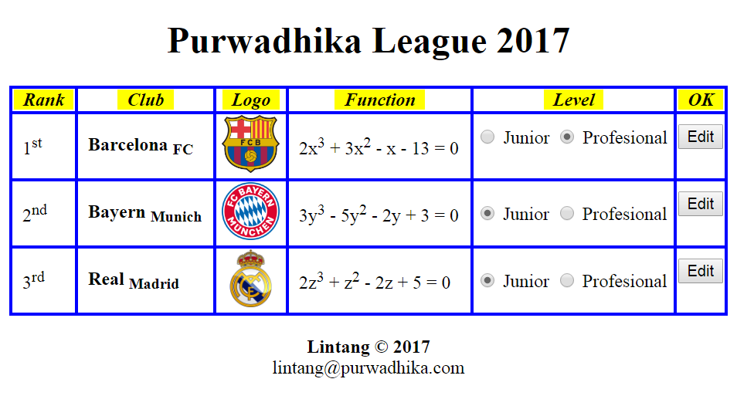
Exercise

Slide 12
Introduction to
HTML

